Slide 1
Dialogue Summarization

Slide 2
By
[Team ID:7]
Name | Madhurima Sen | Rashmita Roy
University Roll No | 10400117154 | 10400117116
Class Roll No | 114 | 78

Slide 3

CONTENT
What is NLP?
What is Summarization & its type
Scope of dialogue summarization
Previous studies on dialogue summarization
Project Illustration(with result )
Conclusion

Slide 4
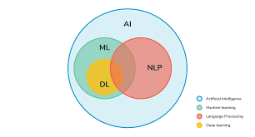
What is Natural Language Processing?
Natural language processing (NLP) is the ability of a computer
program to understand human language as it is spoken.
NLP is a component of artificial intelligence (AI).

Slide 5
Application of NLP
Speech processing
Information extraction
Machine translation
Question answering
Summarization
Sentiment analysis

Slide 6
What is summarization & its type ?
Text summarization refers to the technique of shortening long pieces of text. The intention is to create a coherent and fluent summary having only the main points outlined in the document.
Extractive summarization : important information or sentence are extracted from the given file or original document.
2. Abstractive summarization : It reproduces important material in a new way after interpretation and examination of the text using advanced natural language techniques to generate a new shorter text that conveys the most critical information from the original one.

Slide 7
Scope of dialogue summarization
Dialogue that acts as an info-dump or contains tedious life stuff will frustrate and bore a reader. One way to avoid unnecessary dialogue is to use summarized dialogue. Instead of dictating exactly what a character says, we can sum it up and keep it as part of the narrative. So in this project we shall try to implement a dialogue summarizer model based on different techniques of Natural Language Processing.

Slide 8
Previous Work
Previous work has mostly been focused on extractive approaches for meeting summarization (Garg et al. 2009; Murray et al. 2008). These works focuses on learning a model to classify sentences as important/unimportant. Recently many different approaches are taken towards abstractive summarization. Banerjee et al. (2016) uses the dialogue structure directly to generate summary sentences . Mehdad et al. (2013) used clustering of sentences and building entailment graphs followed by aggregation using word graph model. Query based ranking approach was used in (Mehdad et al. 2014). They try to simplify conversations using discourse relations. But they have a lot of complex rules that helps them remove less important information from the conversation.
Most summarization techniques discussed so far are designed in a way that they work well on organized texts such as news articles, where all documents have few grammatical errors and less redundancy. So instead of trying to convert conversations directly into summaries we experiment by trying to convert our conversation into a structured and organized text document.

Slide 9
Project description
Dataset:
5 dialogues on 5 different topics. We are trying to extract a brief idea on that topic from these 5 conversations on that specified topic. Each dialogue contains approx 15-20 lines of speeches(20-25 sentences).
Dialogue on advantages and disadvantages of online classes.
Dialogue on Pollution.
Dialogue on global warming.
Dialogue on Social Distancing.
Dialogue on Career choice.

Slide 10
Steps:
Dialogue Simplified text
Data Preprocessing
Stop word removal
Stemming
Lemmatization
Word embedding
Applying different models (Textrank model )
After textrank algorithm, processing the summary so that it becomes ordered and meaningful
Model evaluation

Slide 11
Dialogue to text conversion
We are using a very simple approach to convert dialogue to text based upon the end pucntuations. A simple explanation follows
1. Speaker: How are you?
Speaker asked how are you.
2. Speaker: It is too good!
Speaker exclaimed it is too good.
3. Speaker: I am fine.
Speaker said I am fine.

Slide 12
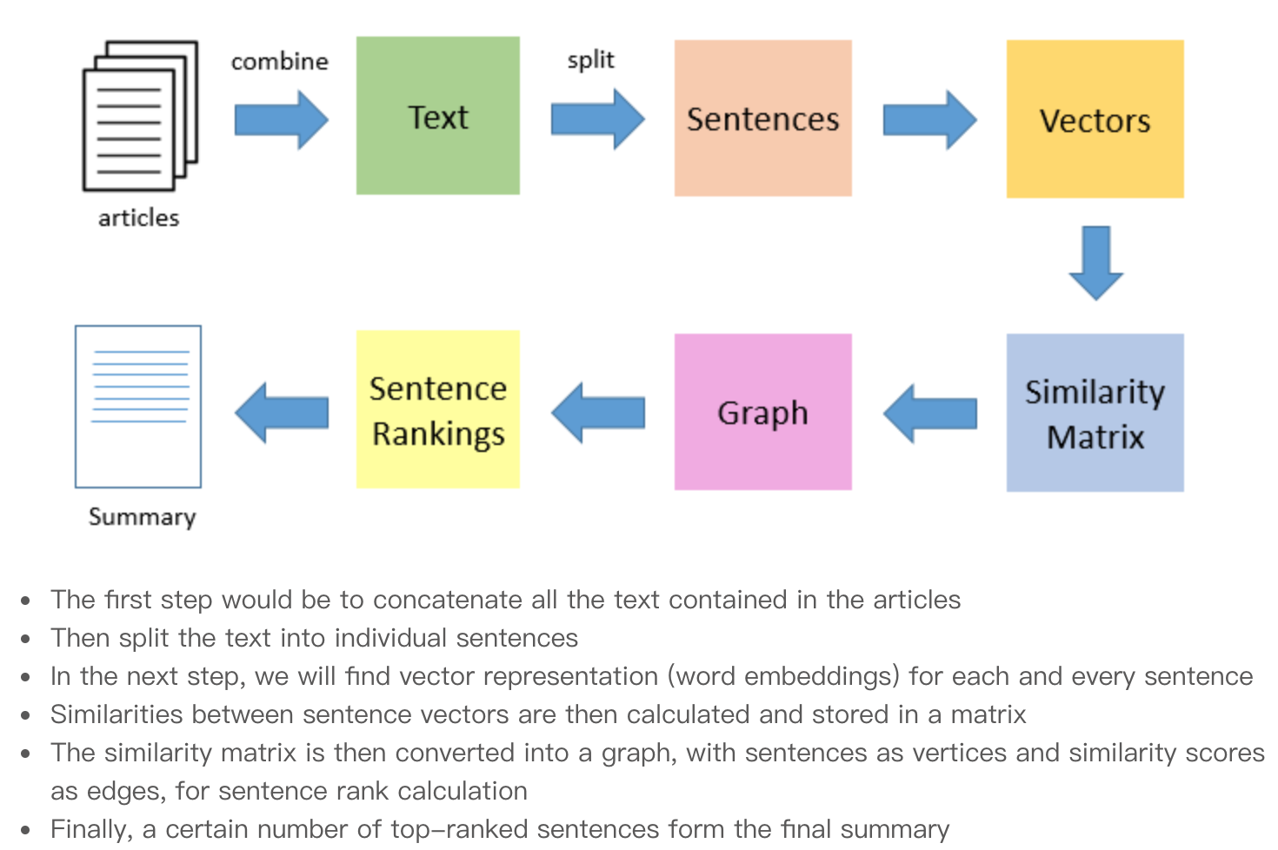
Textrank Model

Slide 13
Arranging Outputs in the order speaker said
As textrank algorithm is an extractive method of text summarization, it just fetches the important sentences from the text. We need to arrange the fetched sentences in the order as they have appeared in the actual dialogue to make the summary understandable and meaningful!

Slide 14
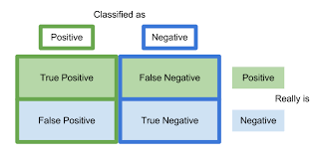
Model Evaluation
Precision
Recall
Rouge Score

Slide 15
Result
Human referenced summary:
Ankita asked that Hi Kavya how are you doing . Kavya said that I am doing good and asked that How about you . Ankita said that I am good as well and asked that How are you dealing with Delhi’s pollution . Kavya said that It’s really terrifying especially in winters and said that I recently ordered a pollution mask to decrease the effect of pollution but we cannot wear it all the time and asked that But what we need to do at home . Ankita said that Air purifiers and asked that Don’t they work well . Kavya said that They do but not everyone can afford it and asked that Furthermore would you want to operate them for hours every day and many months . Ankita said that You have got a point and said that I’m also thinking to buy a pollution mask and asked that What would you suggest . Kavya said that I purchased an N90 mask for INR 2 500/- and said that I have examined the cheap ones as well the one that cost 20-30 rupees for a single piece.

Slide 16
Output of Textrank Model :
Ankita said that I am good as well and asked that How are you dealing with Delhi’s pollution . Kavya said that It’s really terrifying especially in winters and said that I recently ordered a pollution mask to decrease the effect of pollution but we cannot wear it all the time and asked that But what we need to do at home . Kavya asked that What about pollution from fireworks on Diwali . Ankita said that There have been some limitations on the use of crackers at least in Delhi but implementation is not easy and said that To be fair I am not too concerned about crackers because their impact is only for a few days and said that I am more bothered about the month-on-month high level of pollution rising out of other circumstances .Kavya said that I agree but I think residents too have some part in controlling pollution and said that We can stop people from burning polythene bags and other dangerous waste in winter and said that We can also reach construction activities in our area during the period it is forbidden .

Slide 17
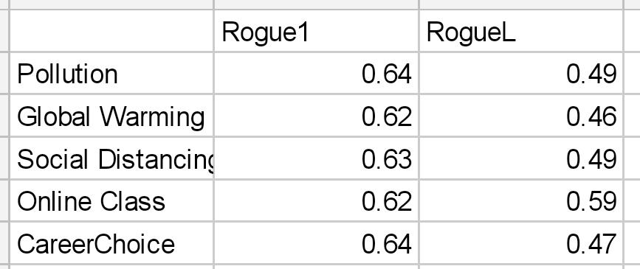
Table: F1-measure

Slide 18
Conclusion
Conversations are in form of dialogues containing spontaneous utterances with speech disfluencies. This makes them cumbersome, complex and time consuming to read. And hence, there has been increasing demand for the creation of systems to automatically summarize both text and spoken conversations. So far, there are different techniques available for normal text summarisation but not many techniques are available for dialogue summarisation. Hence it is a challenging task for us to implement this model with as much simplicity as possible!

Slide 19


